Slide 1

Lesson 1
Introduction to NLP

Slide 2
Plan
History
NLP tasks
Word representations
Meaning from context
Bag-of-words
Latent semantic analysis
TF-IDF

Slide 3
Natural Language Processing (NLP)
This is a subfield of computer science about how to program computers to deal with natural languages (English, Russian...).

Slide 4
History
The concept of human intelligence is largely related to language understanding. For example, Turing test. So, people have long wanted to make the machine speak.
1950 - first attempts, rule based
1980-2010 Statistical methods + first ML methods such as decision trees
2010s Neural networks + few statistical methods

Slide 5
NLP tasks (1)
Machine Translation Between different languages
Language modeling Model which can predict probability of sentence, or word, given context
Part of speech tagging Determine part of speech for each word
Parsing Determine parse tree for sentence which shows relations between words

Slide 6
NLP tasks (2)
Natural language generation Convert some information (images, digits) into human readable way
Named entity recognition Determine which items in text map to proper classes. For example, people or organizations
Question answering Given a human language question, determine its answer
Topic modeling Extract topics and determine which relate to text
...

Slide 7
To deal with NLP tasks we need somehow represent words and texts in computer adapted way.

Slide 8
Word representations
We can regard word as a discrete symbol.
One-hot vectors of dictionary size (ex. 500,000).
mother = [0...0,1,0...0]
cat = [1,0...0]

Slide 9
One-hot problems
These vectors do not contain meaning.
There is no natural similarity measure between two such vectors.
Each word is orthogonal for all other.
How can we put the meaning into the vector?

Slide 10
Meaning from context
What is the meaning of word bicycle?
Marie rode a bicycle
Bicycle wheel was punctured
The bicycle has a beautiful white frame.
…
After these sentences we can say that bicycle is something what you can ride, it has wheel and frame.
How can we put this information into the vector?

Slide 11
Meaning from context
We see that there is some distribution on contexts given word.
For example word “wheel” occurs more frequently with word bicycle than word “Moon”.
What other words fit these examples?
Marie rode a _____
_____ wheel was punctured
The _____ has a beautiful white frame.

Slide 12
Meaning from context
What other words fit these examples?
Marie rode a _____
_____ wheel was punctured
The _____ has a beautiful white frame.
Word | 1 | 2 | 3
Bicycle | + | + | +
Bike | + | + | +
Car | + | + | -
Horse | + | - | -

Slide 13
Meaning from context
Does vector similarity means semantic similarity?
Word | 1 | 2 | 3
Bicycle | + | + | +
Bike | + | + | +
Car | + | + | -
Horse | + | - | -

Slide 14
Distributional hypothesis (Firth, 1957)
Words that are used and occur in the same contexts tend to purport similar meanings

Slide 15
Meaning from context
We can count co-occurrences of words.
Having a corpus (bunch of texts) for each word we calculate vector:
Each word in vocabulary has it’s own index j.
v(word_i)[ j ] = count(co-occurrences word_i with word_j)
Example: v(word) = [12,1,2,0,5,...]

Slide 16
Context embeddings
v(word) = [12,1,2,0,5,...]
This is a big vector (vocabulary size)
We can squeeze it with dimensional reduction methods
Dimensional reduction
[12,1,2,0,5...]
[5.5,4.3,...]

Slide 17
Bag-of-words
Bag-of-words is a model where a text is represented as as bag (multiset) of its words.
We do not consider word order here.
Sentence: "John","likes","to","watch","movies","Mary","likes","movies","too"
BoW = {"John":1,"likes":2,"to":1,"watch":1,"movies":2,"Mary":1,"too":1}

Slide 18
N-gram Bag-of-words
Instead of words we do the same with n-grams:
[ "John likes", "likes to", "to watch", "watch movies", "Mary likes", "likes movies", "movies too", ]

Slide 19


Singular Value Decomposition (SVD)
SVD:
M (m x n) - real matrix
U (m x m) - orthogonal matrix
(m x n)- diagonal matrix with non-negative real numbers on the diagonal (singular values)
V (m x m) - orthogonal matrix

Slide 20
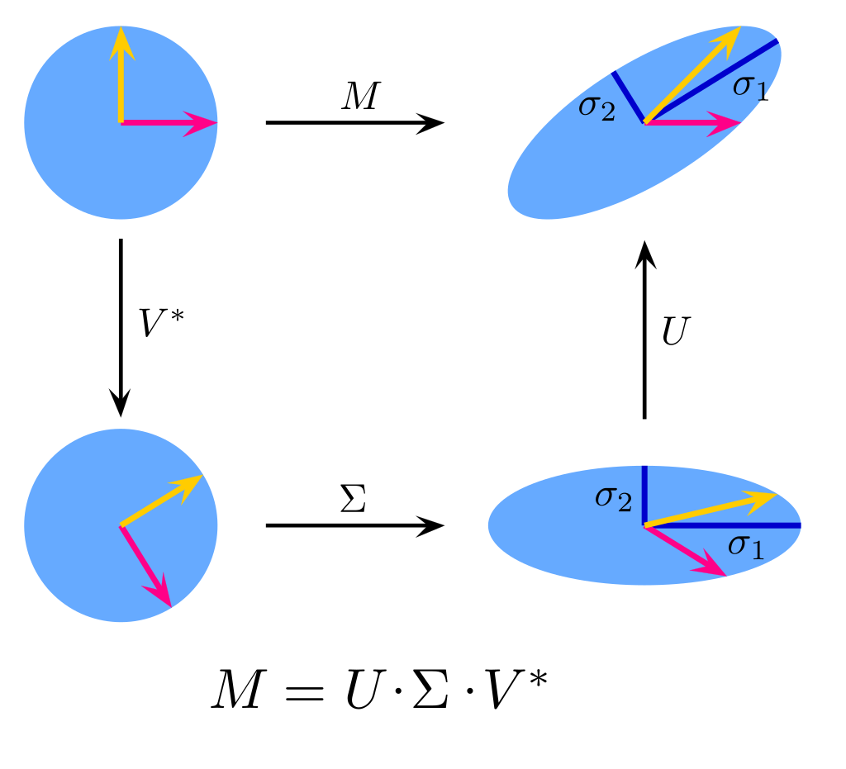
Singular Value Decomposition (SVD)

Slide 21
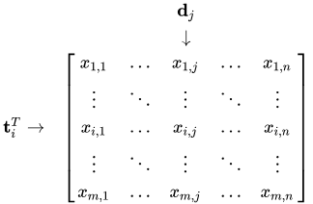
Latent Semantic Analysis (LSA)
Let X be the matrix where is i-th term (word) and is j-th document.
X (vocab_size x corpus_size)

Slide 22


Latent Semantic Analysis (LSA)
Dot product gives correlation between two terms in the corpus, analogically with documents.
Let’s use SVD
If you take k biggest singular vectors you will get the rank k approximation to X with the smallest error (Frobenius norm)
Now we can treat terms and documents as semantic space
Finally we have small representations for terms and documents with meaning We can compute similarity with cosine metric.

Slide 23
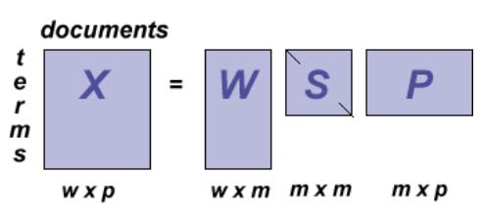
Latent Semantic Analysis (LSA)

Slide 24
TF-IDF
Term frequency–inverse document frequency.
We want to represent sentence or document with a vector, based on words we see in this document (also n-grams)

Slide 25


TF-IDF
Term frequency:
is number of times term t occurs in document d
Such view is needed to prevent a bias towards long documents

Slide 26

TF-IDF
Inverse document frequency:
N - total number of documents in corpus
Denominator is the number of documents where t appears

Slide 27
TF-IDF

